Slide 1
Introduction to Research Methods: Surveys, Interviews, & Focus Groups
Jessica Tollette, PhD
Comillas Universidad Pontificia
November 7, 2019

Slide 2
Introduction
Qualitative Sociologist ( PhD, Harvard University)
  Race, Identity, Migration Scholar
  Instructor: Introduction to Research Methods
Academic Director and Professor at IE University Madrid
  Bachelor in Behavior and Social Sciences
  Instructor: Qualitative Tools for Studying People
Fulbright Scholar
Former Management Consultant (Monitor Deloitte)

Slide 3
Agenda for Today
Introduction to Research: Matching the Method to the Research Goal
Surveys
Interviews
Focus Groups
Wrap up and Conclusions

Slide 4
Introduction to Research
Qualitative vs. Quantitative Methods & Research Goals

Slide 5
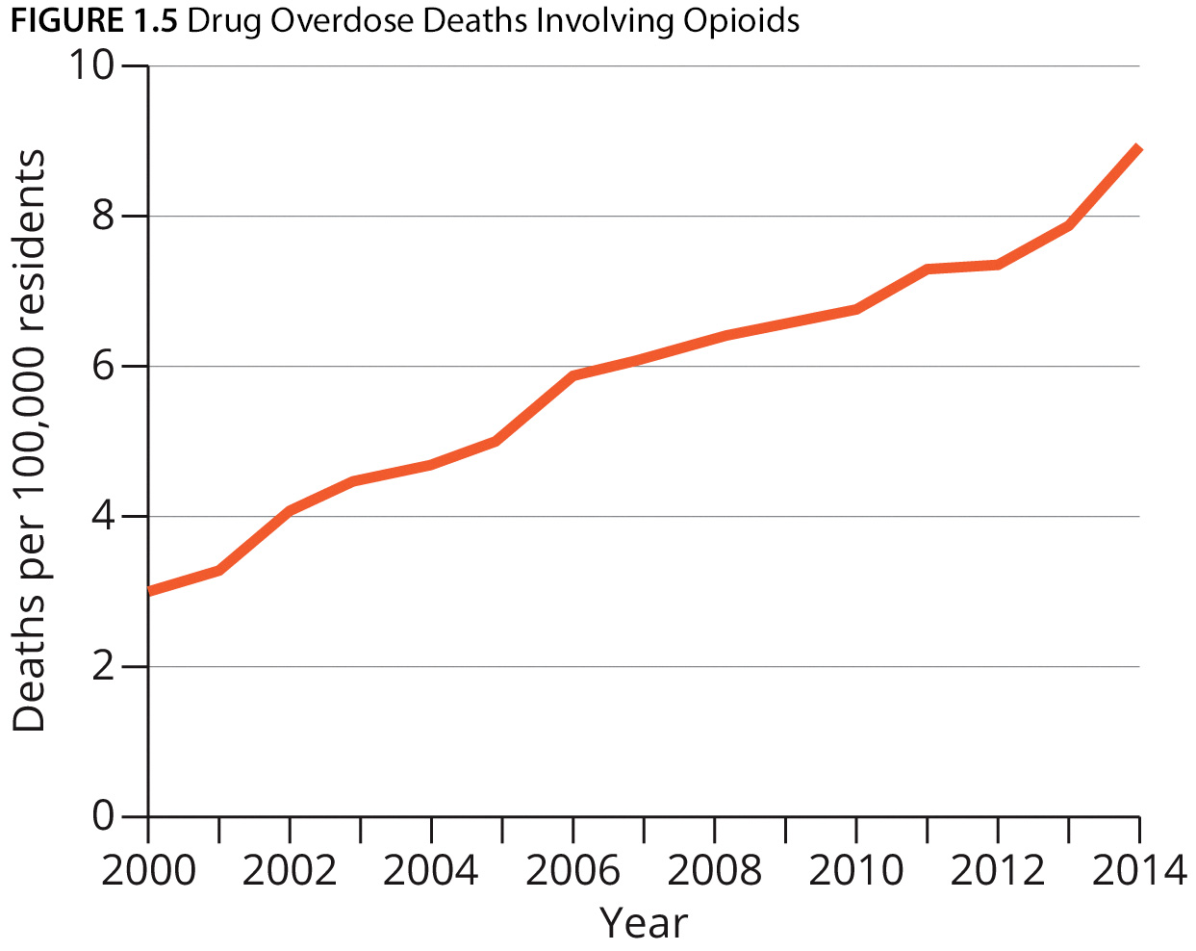
Quantitative Research
Quantitative methods rely on data that can be represented by, and summarized into, numbers.
Quantitative research questions usually start with “what,” “how,” or “why.”
Looks at connections, relationships or comparisons between variables
Examples: Surveys, experiments, network analysis

Slide 6
Sample Quantitative Research Questions
How often do students exercise at the University level?
What is the relationship between years worked and Company loyalty?
To what extent does social class, predict education levels?
Is there a significant difference between men and women with regards to frequency of job promotion?
How does work-related stress impact quality of life among medical doctors?

Slide 7
Qualitative Research
Qualitative methods collect and analyze data that enable rich description in words or images.
Qualitative research questions usually begin with “what” or “how.”
Typically aim to describe, explore, generate, discover or understand
Examples: ethnography, in-depth interviews, focus groups

Slide 8
Sample Qualitative Research Questions
What challenges are encountered by people who switch careers later in life?
What are the experiences of college students using smartphone applications for dieting?
How do adolescent Latinas/Latinos conceptualize classroom participation processes?
What role does the therapist’s religion play in the treatment of his or her patients?
How do migrant youths adapt to educational settings when they do not speak the local language?
What strategies are being used by small businesses that have effective and viable workplace wellness programs?

Slide 9

Quantitative v. Qualitative Research
Numbers
Point of view of researcher
Researcher distant
Theory testing
Structured
Generalization
Hard, reliable, data
Macro
Causal explanations
Words
Points of view of participants
Researcher close
Theory emergent
Process
Contextual understanding
Rich, deep data
Micro
Understanding perspectives

Slide 10
Research Goals: Descriptive Research
Descriptive research documents or describes trends, variations, and patterns of social phenomena.
It can explain what is happening, but not necessarily how or why.
Descriptive research can use either quantitative or qualitative methods.

Slide 11
Research Goals: Exploratory Research
Exploratory research tends to answer questions of how, with the goal of documenting precisely how particular processes and dynamics unfold.
Qualitative methods are best suited for exploratory research

Slide 12
Research Goals: Explanatory Research
Explanatory research: documents the causes and effects of social phenomena, addressing questions of why
Quantitative methods are best suited for exploratory research

Slide 13
Introduction to Survey Research
What are surveys? What can they do? What types of surveys are there? How do I conduct survey research?

Slide 14
What Are Surveys?
A survey is a social research method in which researchers ask a sample of individuals to answer a series of questions.
Surveys are highly structured, meaning that they ask prewritten, mostly closed-ended questions with fixed response options.

Slide 15
What Are Surveys Used For?
Surveys allow social researchers to test hypotheses, explore subgroup differences in attitudes and opinions, document patterns of stability and change over time, and develop theories of human behavior.

Slide 16
Survey Design
Cross-sectional v. Longitudinal

Slide 17
Cross-Sectional Versus Longitudinal Designs
Cross-sectional surveys are surveys for which data are collected at only one time point.
Longitudinal surveys are studies in which data are collected at multiple moments in time.
Types of longitudinal surveys
  Trend studies: data are collected at multiple time points, from different subjects at each time point but about the same topics or questions.
  Panel surveys: data are collected on the same subjects at multiple time points.

Slide 18
Cross-Sectional Designs: Pros & Cons
Low cost (respondents only contacted once)
Easy to administer
X Cannot establish causality
X Biases: samples exclude difficult to reach populations

Slide 19
Longitudinal Designs: Pros & Cons
well suited to see how people change over time
can establish causality - measures at one wave can be used to predict outcomes in the second wave
X high cost as respondents need to be tracked
X difficult to administer because it requires follow up after long periods of time
X Biases: samples exclude difficult to reach populations, loss of respondents over time

Slide 20
Preparing Surveys

Slide 21
Types of Survey Questions: Closed-Ended Questions
Two types of survey questions: closed-ended and open-ended
The most basic type of closed-ended questions is dichotomous, which requires a simple “yes” or “no” answer.
Regardless of the number of response categories, closed-ended questions should always be mutually exclusive and exhaustive.
  No overlapping categories (mutually exclusive)
  Address all of the possible responses a respondent could have (exhaustive)

Slide 22
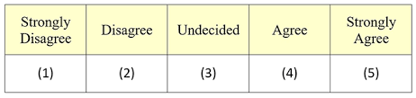
Types of Survey Questions: Closed-Ended Questions, cont’d.
Closed-ended questions often use rating scales. A common rating scale is the Likert scale, which captures the respondent’s level of agreement or disagreement with a particular statement.
Some researchers believe that forced-choice questions produce the best quality data.
  No “neutral” “undecided” or “I’m not sure” options

Slide 23
Types of Survey Questions: Open-Ended Questions
Open-ended questions typically take one of two forms in surveys:
  Open-ended responses embedded in closed-ended questions, such as “other: _____”
  Purely open-ended questions, in which respondents can write a response in their own words
Open-ended questions can provide new insights that the researchers had not previously considered when writing the survey.
To report their findings, researchers can either transform open-ended responses into closed categories or present illustrative quotes from the open-ended responses.

Slide 24
Closed- or Open-Ended Questions?
Some things to consider:
  The goals of the survey
  The respondent’s knowledge about the topic
  How much thought a respondent has given to a particular topic
  The respondent’s motivation to answer the question
Closed-ended questions are preferable for documenting frequencies of behavior, factual information, and levels of agreement or disagreement.
Open-ended questions are useful when the respondent has no previous knowledge or opinion about the topic. (Consider using interviews)

Slide 25
Writing Good Survey Questions – Part 1
Use clear and simple language.
Avoid double-barreled questions.
  Asking about two ideas in the same question.
Define abbreviations the first time they are used.
Define concepts that are not easily recognizable by non-experts.
Have someone check the translation if conducting in a non-native language.

Slide 26
Writing Good Survey Questions – Part 2
Do not assume that respondents will have prior knowledge about complex issues.
Make response categories as precise as possible.
Use neutral language when dealing with sensitive or emotionally laden topics.
Avoid leading questions.

Slide 27
The Placement of Survey Questions: Establishing Rapport
Researchers should establish rapport with respondents early in the survey to obtain high-quality data.
The first questions asked in a survey should be simple, easy to answer, and unobtrusive.
Demographic questions should be asked at the end of the survey.

Slide 28
The Placement of Survey Questions:
Avoiding Monotony and Response Set
Alternate modules on “fun” topics with the more serious modules.
Vary either the response categories or the positively and negatively worded questions to help avoid response set.
  Response set is the tendency to select the same answer to a series of questions.
For example:
  On the whole, I am satisfied with myself.
  At times I think I am no good at all.
  I feel I have a good number of qualities.
  I feel useless at times.

Slide 29
The Placement of Survey Questions: Avoiding Order Effects
Order effects occur when the order in which questions appear biases the responses.
Priming effects are a type of order effect in which exposure to a particular image, word, or feeling shapes how respondents think and feel in the immediate aftermath.
  Example: the effect of recalling politicians involved in scandals on the ratings of currently elected officials

Slide 30
Conducting the Survey: The Pretest
A pretest is a trial run of a survey administered to a group of people who are similar to the study sample.
The pretest should be conducted in precisely the same way that the final survey will be conducted.
Pretesting may also include a cognitive interview.

Slide 31
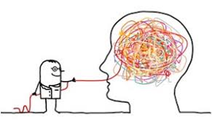
What is a Cognitive Interview?
Cognitive interviews are used primarily to pretest survey questions, as they involve participants thinking aloud about their responses.
They are useful for learning about how participants interpret questions being planned for a survey, and they also allow the researcher to develop new survey questions based on the feedback from participants.

Slide 32
Conducting the Survey: Conducting Preliminary Data Analyses
Researchers can use both “soft” and “hard” data to analyze the pretest.
  Information from the cognitive interviews as well as preliminary data analysis.
Frequency distributions help researchers assess problems with the questions, such as a large percentage of respondents choosing the answer, “I don’t know.”
If the frequency distribution for a question shows clustering, it may indicate the need for more specific response categories.

Slide 33
Conducting the Survey: Launching the survey
After the survey has been pretested and revised, researchers are ready to go into the field.
At this point, they may send advance mailings about the survey to respondents.
Regardless of the survey mode chosen (telephone, mail, online, face-to-face), the researchers’ initial contact with respondents should involve a brief explanation of the survey and obtain informed consent.

Slide 34
Ethical Concerns in Survey Research: Confidentiality
Researchers must protect the confidentiality of their respondents’ survey responses, but it is unrealistic and impractical for survey researchers to promise complete anonymity to their respondents.
  Anonymity – no way to identify a person from the information provided (e.g. keep personal details separate from survey responses)
  Confidentiality – although you can identify someone, promising not to
To maintain confidentiality, researchers often assign an ID number to each survey respondent, which serves as the only identifying information visible on the survey.
Any documentation that links the ID number to respondents’ personal information must be held in a private and secure location.

Slide 35
Ethical Concerns in Survey Research:
Psychological Distress
Researchers should be sensitive to survey questions that may cause respondents to experience minor psychological distress.
This harm can be minimized by warning respondents about any distressing questions ahead of time, providing them with access to appropriate support resources, and reminding them that their participation in the survey is voluntary.

Slide 36
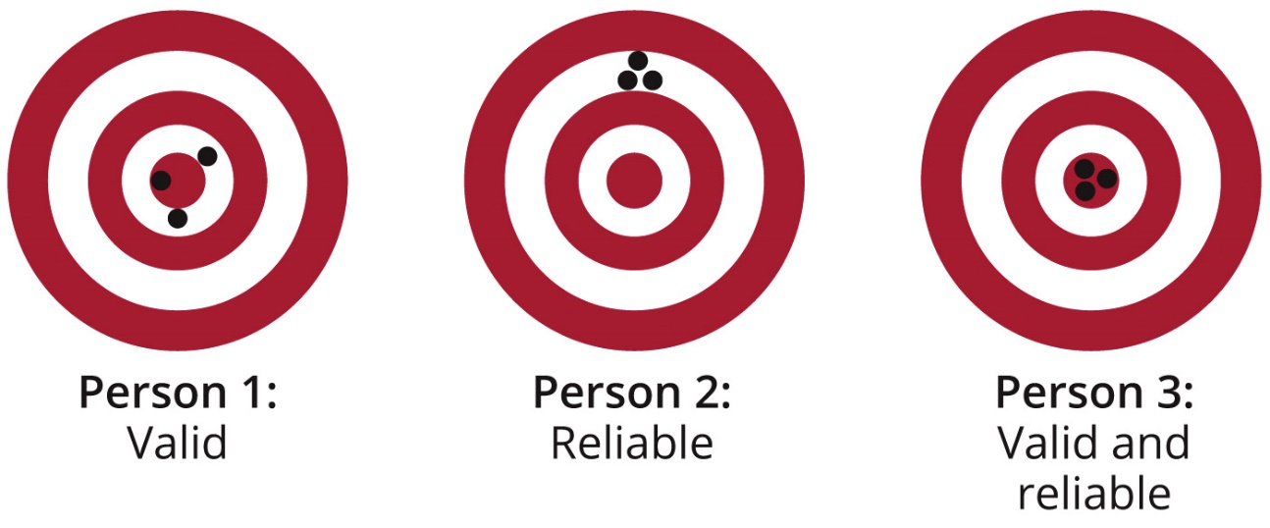
Reliability and Validity
Reliability is a quality of a measure concerning how dependable it is. Are the measures consistent?
Validity is quality of a measure concerning how accurate it is. Are the conclusions well-founded?
Researchers aim to maximize both reliability and validity, but they may need to make trade-offs in their research design.

Slide 37
Strengths of Surveys
Breadth: urveys can cover a wide range of topics in a short amount of time
Cost effective – can create and send surveys online for free
Allow researchers to compare data across groups and over time
Reliable – same questions, posed in the same way. Very consistent
Generalizability due to probability sampling strategies

Slide 38
Limitations of Surveys
Nonresponse and low response rates
  Respondents may choose not to participate in a survey at all or they may choose not to respond to particular questions on the survey.
  If individuals who do and do not respond differ in systematic ways, then the results of the study may be biased.
Validity – closed-ended questions may have lower validity
Inflexibility – responses tend to be fixed, cannot address any questions or confusion from respondents

Slide 39
Sampling

Slide 40
Sampling
Sampling refers to the process of deciding what or whom to observe when you cannot observe and analyze everything or everyone in the target population.
As long as the appropriate sampling strategy is used to obtain a sample of a target population, social researchers can have confidence that the sample accurately represents the target population.

Slide 41
Probability Sampling
If the goal is to obtain a sample that does not systematically differ from the population being studied then the solution is a probability sample.
Probability samples have two key characteristics:
  Samples are chosen randomly.
  Every member of the population should have an equal chance of being selected into the sample.
Less bias

Slide 42
Non-Probability Sampling
Used when you don’t have the option of probability samples
The simplest type of nonprobability sample is a convenience sample, for which the cheapest and easiest observations are selected.
Example: A professor studying undergraduate study habits selects all students in his/her sociology of education class as part of the sample.
Other non-probability samples include: purposive sampling, snowball sampling and quota sampling
Used in both quantitative and qualitative research but more common in qualitative

Slide 43
Interview Methods
What are interviews? What can they do? What types of interviews are there? How do I conduct interview research?

Slide 44
What are interviews?
In-depth interviewing is a qualitative research method in which the researcher asks open-ended questions to elicit as much detail as possible from the interviewee.
The interview may ask about the interviewee’s experiences, understandings, thoughts, feelings, and/or beliefs.

Slide 45
What are interviews used for?
In-depth interviews are useful for answering questions about how and why events occur.
This method cannot necessarily explain the extent of a phenomenon in a given population. (not generalizable)

Slide 46
Types of Interviews: Unstructured
Unstructured interviews are highly flexible. The researcher will only develop a general list of topics he or she would like to cover.
  Few, loosely defined topics
  Open-ended questions to allow free response
  Conversational style
These interviews may differ from one interviewee to the next.

Slide 47
Types of Interviews: Semi-Structured
For a semi-structured interview, the researcher will prepare a list of questions and follow-up probes but will give retain the freedom to ask questions out of order and will allow the conversation to unfold naturally.

Slide 48
Steps for Conducting an Interview Study
Deciding whom and how many people to interview.
Writing the interview protocol.
Conducting the interview.
Writing field notes and transcribing the interview.

Slide 49
Deciding Whom to Interview
Researchers must first decide whether they are seeking informants or respondents.
An informant has special knowledge about the research question, based on their social or professional position.
A respondent is simply an ordinary person who is being interviewed.

Slide 50
Conducting an Interview Study: Sampling
Snowball sampling is the most commonly used sampling strategy for in-depth interviews.
When using this sampling strategy, the researcher starts with one respondent who meets the requirement for inclusion and then asks him or her to recommend other people to contact.

Slide 51
Deciding How Many People to Interview
Saturation is a rule of thumb used by researchers to decide when they have learned all they can from an interview study.
  Typically around 30 for each group OR when responses begin to get repetitive
Researchers must also consider the study’s budget and whether they have obtained equal representation from all subgroups of the population being studied.

Slide 52
Conducting an Interview Study:
Writing the Interview Protocol
The key to an effective interview is a good interview protocol.
Researchers prepare an interview protocol by designing questions that will allow respondents to give in-depth, conversational responses, and then organizing the questions by topic to ensure that the interview will flow smoothly.

Slide 53
Tips for Writing the Interview Guide
Begin with questions that are easy to answer to build rapport
Ask open-ended questions
Questions should elicit stories, not simple answers.
Don’t ask questions with right or wrong answers

Slide 54
Conducting an Interview Study:
Writing the Interview Protocol, cont’d.
Other strategies for getting interviewees to talk
  Asking for respondents’ opinions as experts
  Prompting respondents with stories about fictional interviewees
  Probe with follow-up questions
  Using vignettes or photos

Slide 55
Conducting an Interview Study:
Writing the Interview Schedule, cont’d.
Vignettes use stories and photos to present a hypothetical situation to respondents so that they can reveal their perceptions, values, norms and impressions
Vignettes and photos can help elicit responses from participants.
This is particularly useful if the topic is one that is difficult to conceptualize through questions alone. (Sensitive topics: identity, emotions, judgements)

Slide 56
Conducting an Interview Study:
Conducting the Interview
It is typically best to record an in-depth interview, but this can only be done with the respondents’ permission (informed consent).
The recorder’s batteries should be checked before every interview, and the researchers should bring spare batteries or a charger cord.
Researchers should do a sound check before the interview begins.
After the interview, researchers should check that the beginning, middle, and end of the interview were recorded.
If the interview was not successfully recorded (field notes), researchers should create a written record while the details are still fresh.

Slide 57
Conducting an Interview Study:
Conducting the Interview, cont’d.
Participants may sometimes be paid a small fee for their participation in an in-depth interview.
In order to avoid making participants feel coerced into being interviewed, payment should not be so high that it is difficult to turn down, and participants must be informed that they will be compensated even if they decide not to complete the interview.

Slide 58
Conducting an Interview Study:
Writing Field Notes and Transcribing
Steps to take after an interview is completed
  Write field notes to capture the researcher’s experiences and observations.
  Type a transcription of the interview by playing back the recorded audio.
Listening to and transcribing a recorded interview will help the researcher gain further insights into the interview and develop new questions to ask future respondents.

Slide 59
Strengths of In-Depth Interviews
Rapport: interviewers can establish rapport with respondents to make them feel comfortable
Follow up: follow up questions and probing for additional information can generate a more detailed and rich understanding of attitudes, motivations and perceptions
In-depth interviews usually have high internal validity because the interviewer can probe respondents with follow-up questions to get a complete and detailed understanding of their thoughts.
Flexibility – unlike surveys, interviews can move and flow in different directions, adapting as you go through the research process

Slide 60
Limitations of In-Depth Interviews
Low external validity (generalizability) because they use nonrepresentative samples
However, interviews typically have low reliability because different interviewers may elicit different responses from the same respondent.
Time consuming – must be transcribed
Costly compared to other methods

Slide 61
Focus Groups

Slide 62
What are Focus Groups?
A focus group is a group interview, led by a moderator, on a specific topic.

Slide 63
What are Focus Groups Used For?
Advertising agencies have long used focus groups for market research in order to create the most effective advertisements.
They are helpful to understand a group consensus on a particular topic or topics. Good for product testing.

Slide 64
Focus Groups versus Interviews
Ways in which focus groups differ from interviews
  They are designed to capture interaction.
  They tend to focus more narrowly than in-depth interviews.

Slide 65
Focus Groups: The Role of Moderators
Focus groups are led by a moderator, who asks questions and manages the flow of the discussion.
Responsibilities of the moderator
  Asking the designed questions
  Keeping participants on topic
  Making sure all participants take part
  Ensuring no single participant dominates the conversation

Slide 66
Focus Groups: Sampling Strategies
Like interviews, focus groups use nonrepresentative samples.
Researchers typically rely on the principle of homogeneity to construct the final focus group – some sort of shared experience or characteristic. Depends on the purpose of the groups.
Use screening criteria to identify relevant participants (age, gender, nationality)

Slide 67
Running Focus Groups
A focus group is ideally comprised of 6-10 individuals who do not know one another.
The social nature of focus groups also means that researchers cannot promise anonymity or confidentiality to participants, though they can emphasize that any information that participants reveal should not be mentioned outside the group.

Slide 68
Focus Groups: Starting the Session
Introduction
  thank people for coming
  introduce yourself and the project
  outline format and procedure
  ethical issues
  collect demographic information
  name cards

Slide 69
Focus Groups: Asking Questions
Two potential approaches
An open-ended approach:
  Encourages discussion between participants
  Allows diversity of views to be heard
or, a more structured approach:
  When the researcher already knows a lot about the topic
  When there is low participant interest

Slide 70
Focus Groups: Ending the Session
Closing remarks
  thank people for participating
  explain what will happen to the data
  arrange any further meetings

Slide 71
Analyzing Focus Groups
Audio recording of a focus group session can be very difficult, as participants may interrupt or speak over one another.
Researchers instead may use a video recording to help identify who is speaking and gain insights about the group interaction.
Need to study not only what people say but who says what
Record of how the topic was discussed
  Processes of collectively defining meanings
  Nuances of language

Slide 72
Strengths of Focus Groups
Gather detailed information on a specific product, topic or idea
Saves time to meet with multiple people at once
Does not require complex statistical analysis
Can get important information from non-verbal responses like body language or facial expressions

Slide 73
Limitations of Focus Groups
Responses are not as detailed as other methods
Potential for biased or dishonest responses based on peer pressure
Sometimes difficult to identify who is speaking
Can be costly, especially compared to surveys
Moderator bias may impact the flow and details of the discussion

Slide 74
Concluding thoughts
Conducting research is difficult.
And complicated.
And full of error.
Using the right tools and right methods to answer your questions is only the first step. Keep in mind your research goals through the process and don’t be afraid of imperfection. ☺
Good luck!

Slide 75

Contact: Jessica.Tollette@ie.edu

Slide 76
Resources
The Art and Science of Social Research, 1st Edition – Carr et al
Social Research Methods, 5th Ed – Alan Bryman
https://www.cfrinc.net/cfrblog/in-depth-interviewing

Slide 77
Backup Slides
Additional Information about conducting research

Slide 78
Research Methods 101
Theories, hypotheses, reliability and validity

Slide 79
Theories & Hypotheses
Theories: explain what we see in the world. They should be testable and encourage future research
Hypotheses: expectations about reality that are derived from theories.
  (Based on X, Y should happen). (If you do this to X, Y should take place).

Slide 80
Steps of the Scientific Method
Identify an important question that needs an answer.
Construct a hypothesis, or prediction, about the answer to this question.
Gather data that allow the researcher to assess the accuracy of this prediction.
Analyze the data to determine whether the prediction is accurate.
Draw and report conclusions.

Slide 81
4 Characteristics of Good Research Questions
Social importance – is there potential for impact?
Scientific relevance – does it resolve an important theoretical or practical puzzle?
Feasibility – how difficult is it to access data? Is the project costly? How much time will it take?
Value free – is this project objective and bias-free?

Slide 82
External Validity
External validity: the degree to which the results of the study can be generalized
  Are the results applicable to other populations?

Slide 83
Reliability and Validity in Qualitative Research
The terms reliability and validity are more common in quantitative than qualitative research.
Qualitative research is more fluid, and researchers adjust their methods and approach throughout the research process.
Qualitative research may instead be best assessed in terms of credibility and dependability.
Credibility: Do the respondents agree with how the researcher is presenting and interpreting their words?
Dependability: Are the findings consistent? Would the findings be the same in different circumstances or contexts?

Slide 84
Research Ethics
Principles of Ethical Research

Slide 85
What are research ethics?
Ethics are the moral system that determines whether actions are right or wrong.
Whenever research involves human subjects, researchers must always question whether or not the research is ethical.
Instances of unethical research occur when the researcher fails to consider all of the ways that the human subjects can be harmed.

Slide 86
What is considered harm?
Physical harm
Damaging self esteem or development
Causing stress
Hurting career prospects or employment opportunities
Breaking confidentiality
Revealing someone’s identity

Slide 87
4 Keys to Conducting Ethical Research
1. No harm should come to research participants
2. They should agree to participate and know what the research is about (informed consent)
3. Their privacy should not be invaded
4. They should not be lied to or cheated (deception)

Slide 88
Survey Strength: Breadth
Nearly all surveys contain basic demographic questions because social scientists are interested in documenting inequalities on the basis of race, age, sex, and other factors.
Beyond this, surveys can take the form of brief, single-topic polls (often used in market research to gather data about a new product) or larger omnibus surveys, which cover a wide range of topics and can be used by social scientists with diverse interests.

Slide 89
Survey Strength: Comparisons across Groups and over Time
The fixed-response categories used in surveys make them ideal sources for measuring differences across groups and change over time.
If identically worded questions produce different responses in a population over time, researchers can be confident that a change took place at a population level.

Slide 90
Survey Strength: Generalizability
Surveys tend to have better external validity (generalizability) than other research methods.
This is especially true if the survey was conducted using a random sample.

Slide 91
Nonresponse in Surveys
Nonresponse
  Respondents may choose not to participate in a survey at all or they may choose not to respond to particular questions on the survey.
  If individuals who do and do not respond differ in systematic ways, then the results of the study may be biased.

Slide 92
Response Rates
Achieving a high response rate is a serious challenge in survey research, and obtaining a 100% response rate is virtually impossible.
Response rates can vary from 20% to 80%, depending on the mode of the survey administered.
The response rate equals the number of surveys completed divided by the number of reporting units.

Slide 93
Measurement Error
Measurement error
  Also called observational error
  It occurs when the approach used to measure a particular variable affects the response provided.
  It may include the survey design (improper wording of a question), the interviewer (incorrect recording of a response)

Slide 94
Coverage error
Coverage error
  The sampling frame does not adequately capture all members of the target population.
  It results from either systematically omitting respondents or including the same respondents multiple times.

Slide 95
Sampling Error
Sampling error
  It involves differences between the characteristics of the sample and the characteristics of the population that the sample represents.
  When the sample is not representative of the desired population
  There is almost always sampling error, good researchers just try to minimize this

Slide 96
Types of Interviews: Oral Histories
When conducting an oral history, people are asked to recall their experiences during a particular historical era or event.
The goal is to preserve the stories of individual people
An oral history is an informal type of in-depth interview that does not seek to develop social theory or test hypotheses.
Since they do not contribute to generalizable knowledge, oral histories no longer require ethics approval to conduct.

Slide 97
Types of Interviews: Life Histories
Life history interviews are similar to oral histories in that they also record events that happened over the course of an individual’s life.
  Subject looks back across their entire life.
  Reveals how they interpret, understand and define the social world (Faraday & Plummer, 1979).
  Shows how life events have unfolded.
The life course is the study of human development over the life span, taking into account how individual lives are socially patterned and affected by historical change.
Unlike oral histories, life histories do contribute to social theory and can be used to test hypotheses about how peoples’ lives change over time.

